Slide 1

Array, Pointers, and References
Using new and delete
The standard C dynamic allocation functions using malloc ( ) and free ( )
In C++, you can allocate memory using new and release it using delete. These operators takes these general forms:

Slide 2
Array, Pointers, and References
Using new and delete
If there is insufficient available memory to fill an allocation request, one of two actions will occur.
Either new will return a null pointer or it will generate an exception.

Slide 3
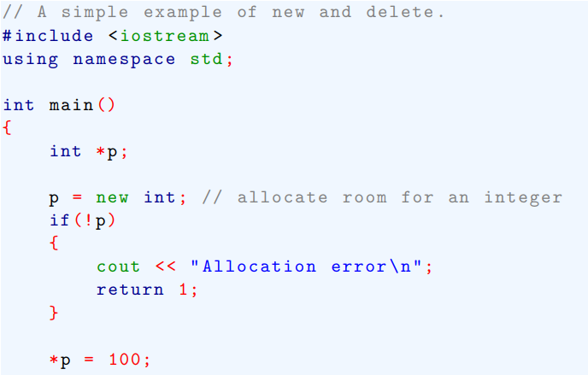
Array, Pointers, and References
Using new and delete
This program allocates memory to hold an integer

Slide 4
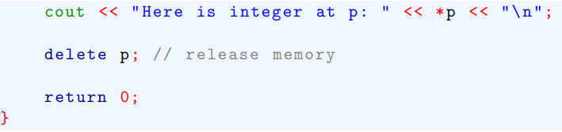
Array, Pointers, and References
Using new and delete

Slide 5
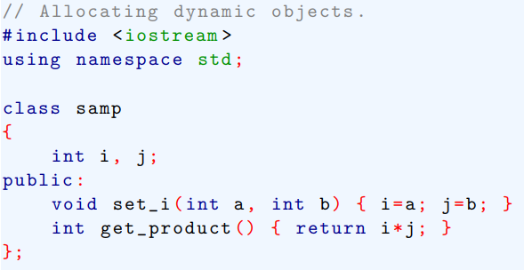
Array, Pointers, and References
Using new and delete
Here is an example that allocates an object dynamically

Slide 6
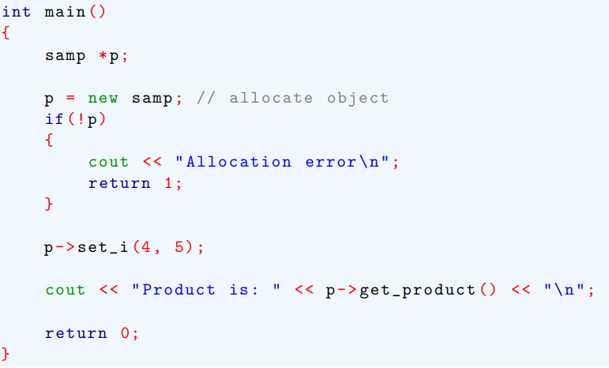
Array, Pointers, and References
Using new and delete

Slide 7

Array, Pointers, and References
Lab Problems:

Slide 8

Array, Pointers, and References
More about new and delete
Two additional features of new and delete.
First, dynamically allocated objects can be given initial values.
Second, dynamically allocated arrays can be created.
To dynamically allocate one-dimensional array, use this form of new

Slide 9

Array, Pointers, and References
More about new and delete
After this statement has executed, p_var will point to the start of an array of size elements of the type specified.
For various technical reason, it is not possible to initialize an array that is dynamically allocated.
To delete a dynamically allocated array, use this form of delete

Slide 10
Array, Pointers, and References
More about new and delete
This syntax causes the compiler to call the destructor function for each element in the array.
It does not cause p_var to be freed multiple times. P_var is still freed only once.

Slide 11
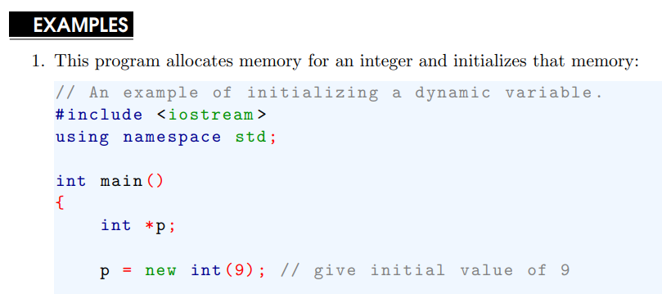
Array, Pointers, and References

Slide 12
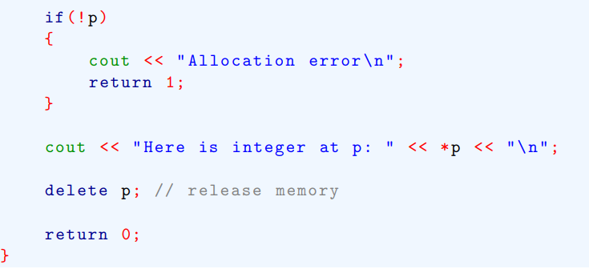
Array, Pointers, and References

Slide 13
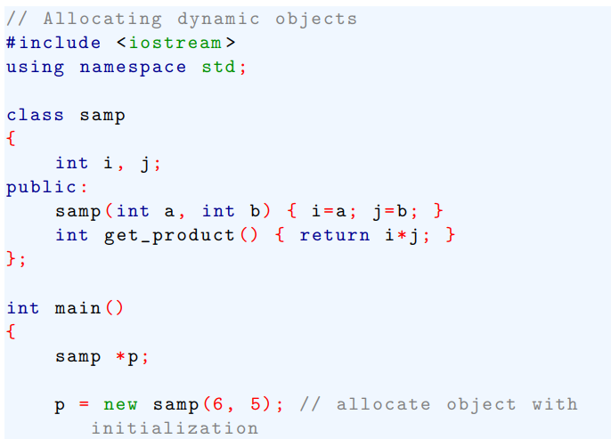
Array, Pointers, and References
The following program passes initial values to a dynamically allocated object

Slide 14
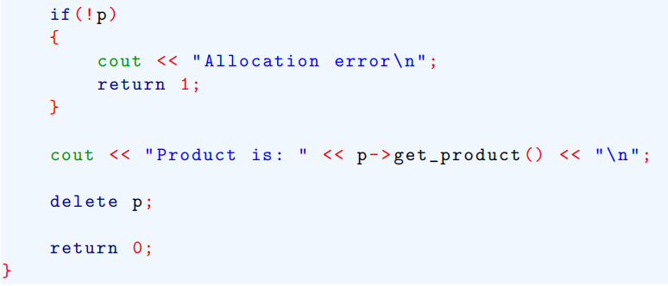
Array, Pointers, and References

Slide 15
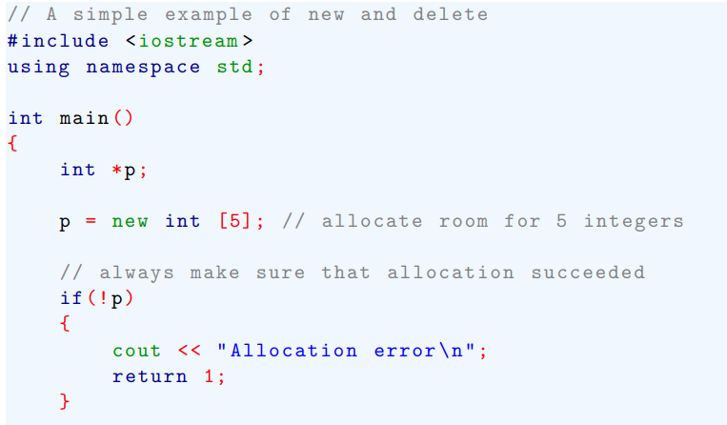
Array, Pointers, and References
The following program allocate an array of integers

Slide 16
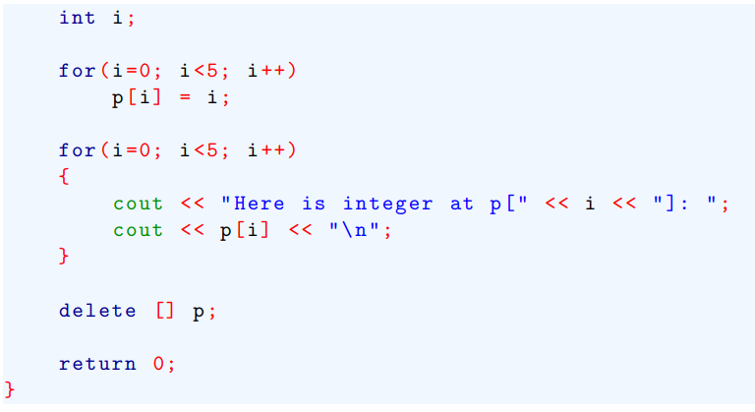
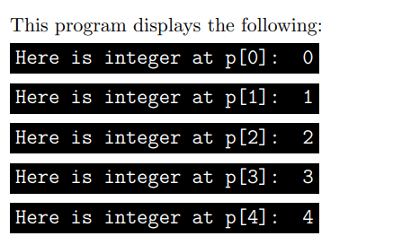
Array, Pointers, and References

Slide 17
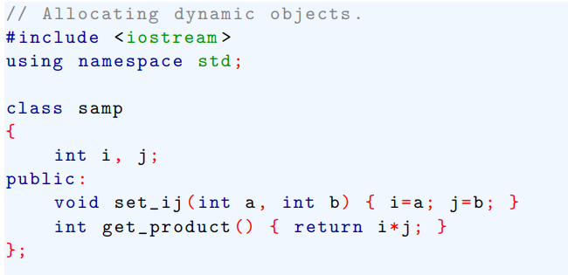
Array, Pointers, and References
The following program creates a dynamic array of objects

Slide 18
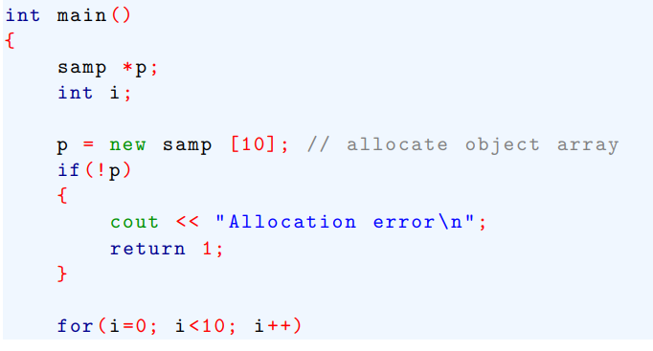
Array, Pointers, and References

Slide 19
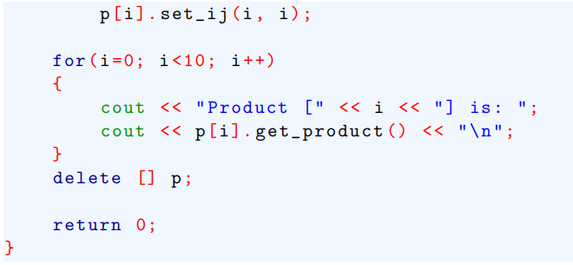
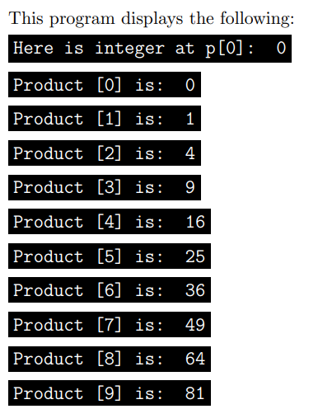
Array, Pointers, and References

Slide 20
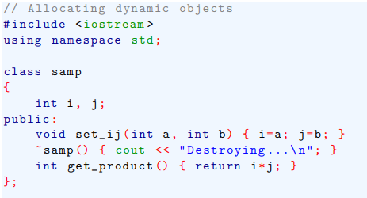
Array, Pointers, and References
The following version of preceding program gives a samp destructor, and now when p is freed, each elements destructor is called.

Slide 21
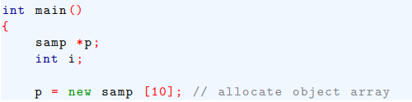
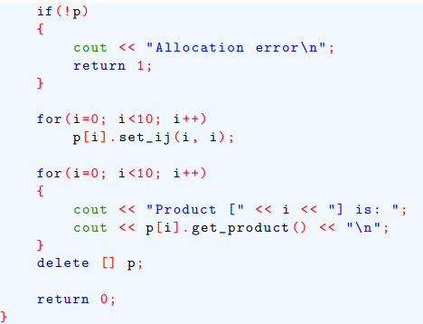
Array, Pointers, and References

Slide 22
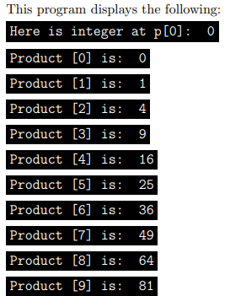
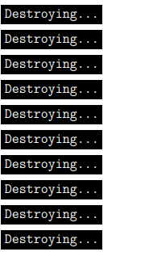
Array, Pointers, and References

Slide 23
References
C++ contains a feature that is related to the pointer: the reference
A reference is an implicit pointer that for all intents and purpose acts like another name for variable.
There are three ways that a reference can be used.
--- First, a reference can be passed to a function
--- Second, a reference can be returned by a function.
--- Finally, an independent reference can be created.

Slide 24
References
The most important use of a reference is as a parameter to a function.
To help you understand what a reference parameter is and how it works, let’s first start with a program that uses a pointer (not a reference) as a parameter.

Slide 25
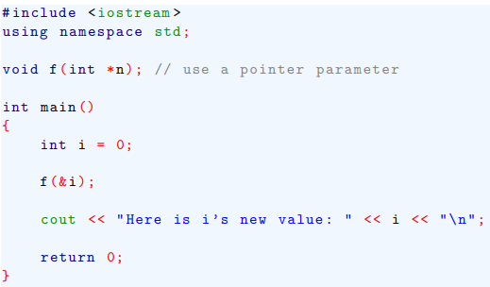

References
This program demonstrates how a pointer is used as a parameter to manually create a call-by-reference parameter passing mechanism.

Slide 26
References
In C program, this is the only way to achieve a call-by-reference.
However, in C++, we can completely automate this process by using a reference parameter.
To see how, let’s rework the previous program.

Slide 27
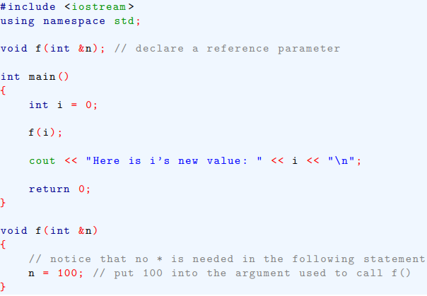
References
Here is a version that uses a reference parameter

Slide 28
References
When we use a reference parameter, the compiler automatically pass the address of the variable used as the argument.
It is important to understand that you cannot change what a reference is pointing to. For example, if the statement
Were put inside f( ) in the preceding program, n would still be pointing i in main( ).

Slide 29


References
Advantages of reference parameter

Slide 30
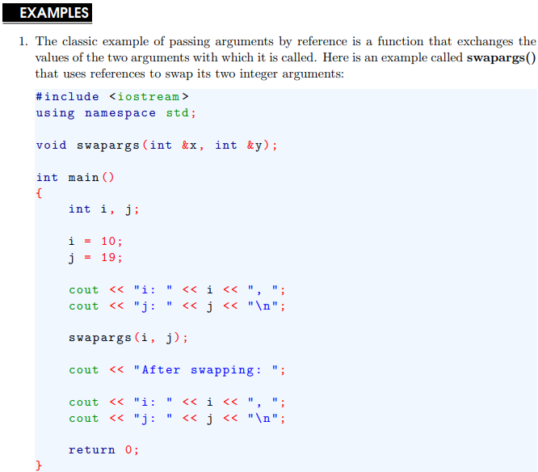
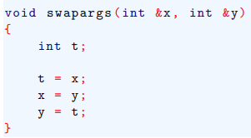
References

Slide 31
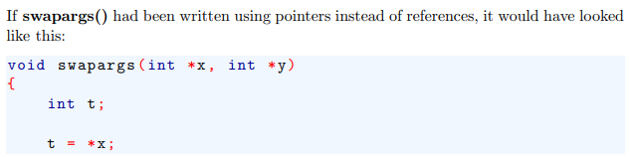
References

Slide 32
Passing References to objects

